Slide 1

Credit Card Prediction
*Andrew Tobin
*Kela Tah
*Shayna Farrow
*Amina Bakare

Slide 2
Our Data
Our data is a collection from a financial institution pulled from https://www.kaggle.com/rikdifos/credit-card-approval-prediction
It is personal information and data submitted by credit card applicants, to predict the probability of future defaults and credit card borrowings.
The two tables used are: Application_record.csv which contains Borrowers personal information, which we used as features for predicting and Credit_record.csv which records users' behaviors of credit card

Slide 3
Our Task
Our Task is to build a machine learning model to predict an applicant’s credit status based on the given parameters.
Steps we used:
WE USED PANDAS TO CLEAN OUR DATA IN PYTHON
First we began by importing libraries
import pandas as pd
import numpy as np
Then we uploaded the file
app_data = pd.read_csv("application_record.csv")
CrRecord_data=pd.read_csv("credit_record.csv")

Slide 4
Explanation of Data
Status
0 = 1-29 days past due
1 = 30-59 days past due
2 = 60-89 days overdue
3 = 90-119 days overdue
4 = 120-149 days overdue
5 = Overdue or bad credit, write-offs for more than 150 days
C = paid off that month
X = No loan for the month

Slide 5
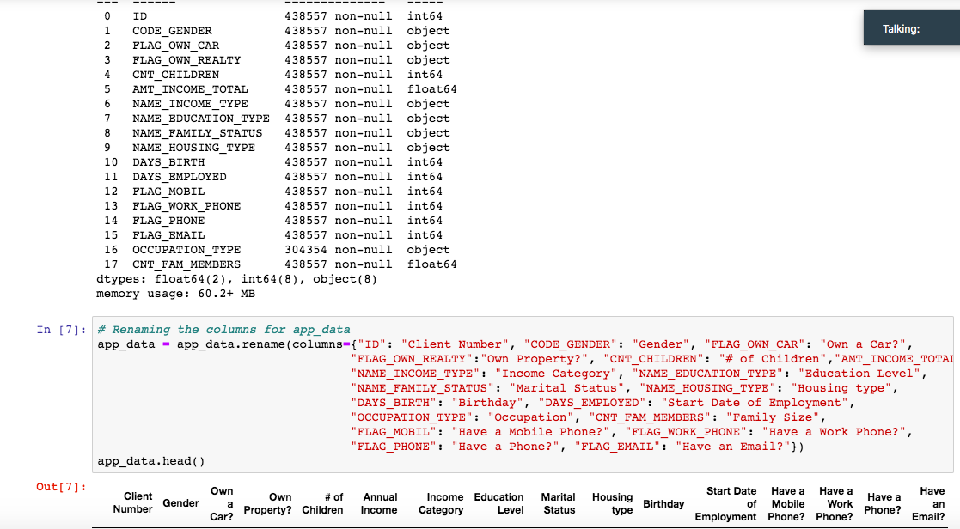
Data Cleaning
Notes:
Switches to Minah

Slide 6
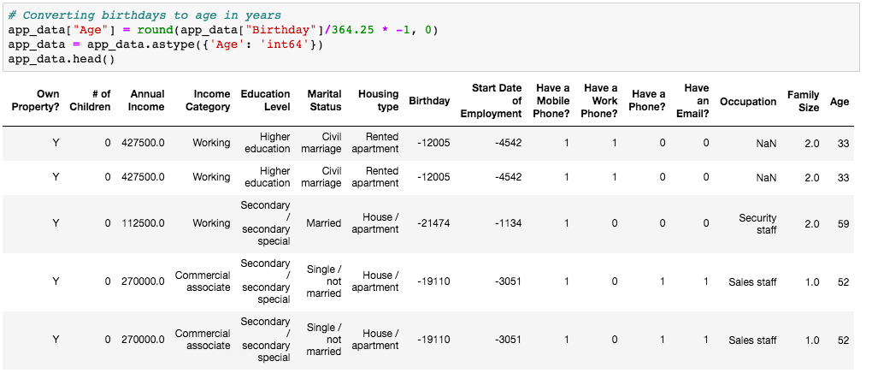
Data Cleaning

Slide 7
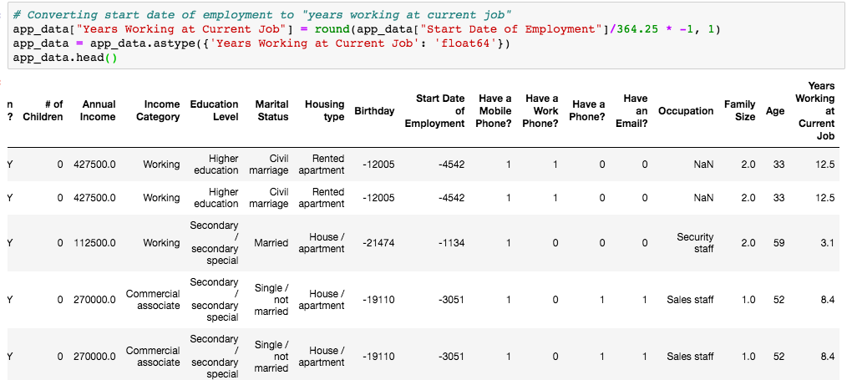
Data Cleaning

Slide 8
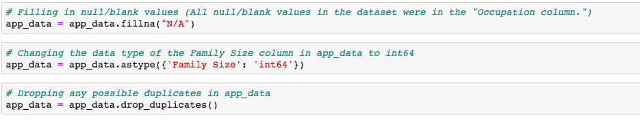
Data Cleaning

Slide 9
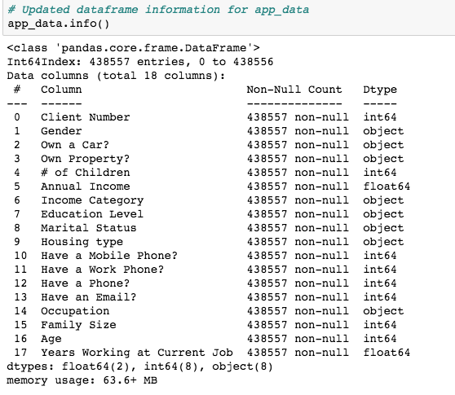
Data Cleaning

Slide 10
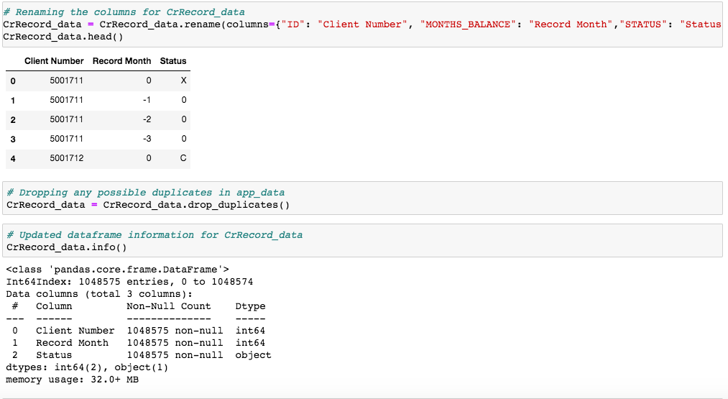
Data Cleaning

Slide 11
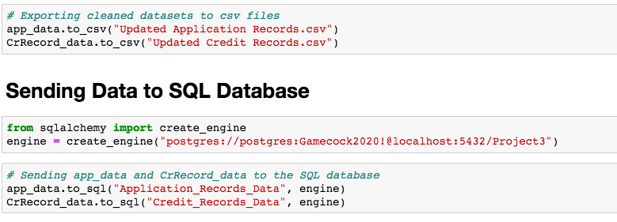
Data Cleaning

Slide 12
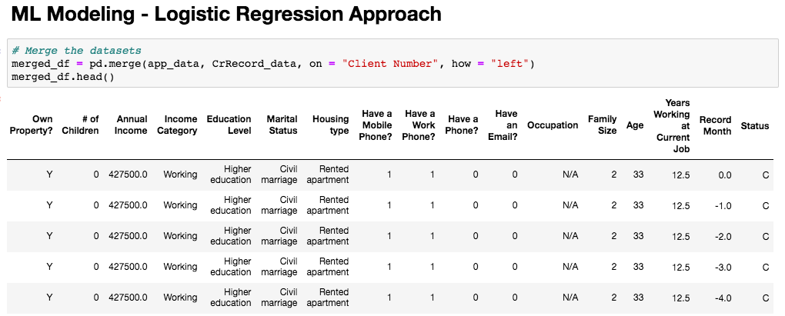
Machine Learning - Logistic Regression
Notes:
For the merging process, we decided to use a left merge on client number. Switches to Andrew

Slide 13
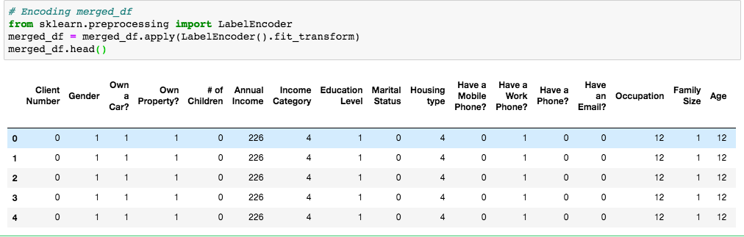
Machine Learning - Logistic Regression
Notes:
Since there were many columns with strings, we had to encode the entire merged dataframe

Slide 14
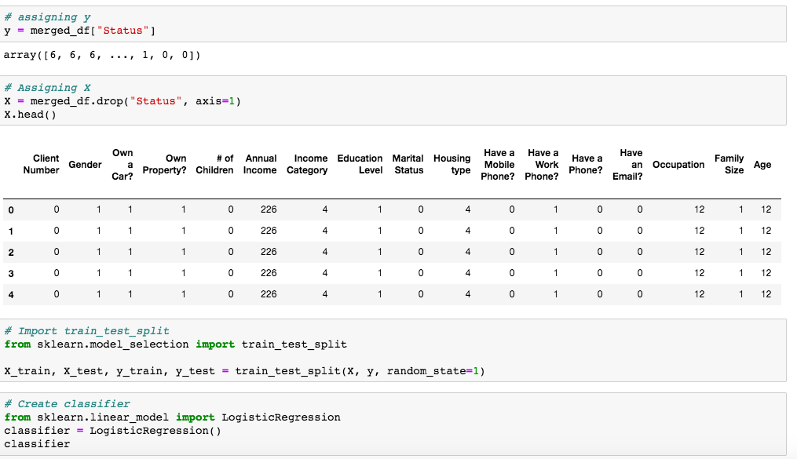
Machine Learning - Logistic Regression
Notes:
Status is our y and the rest of our dataframe will be x. Next we loaded in train_test_split and created the classifier

Slide 15
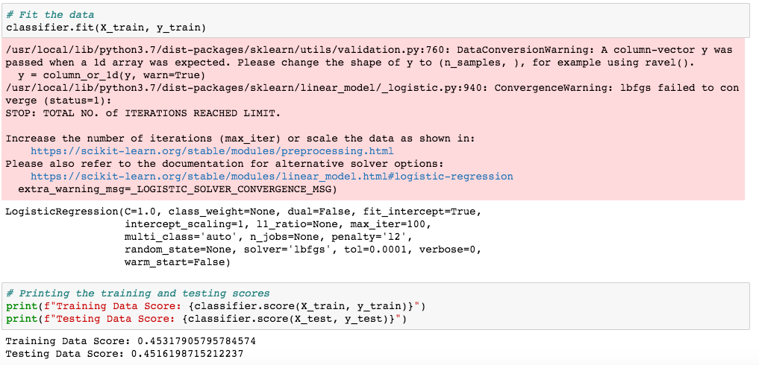
Machine Learning - Logistic Regression
Notes:
Lastly, we fit the model and printed out the model score. As you can see, the logistic regression approach did not give us the best results.

Slide 16
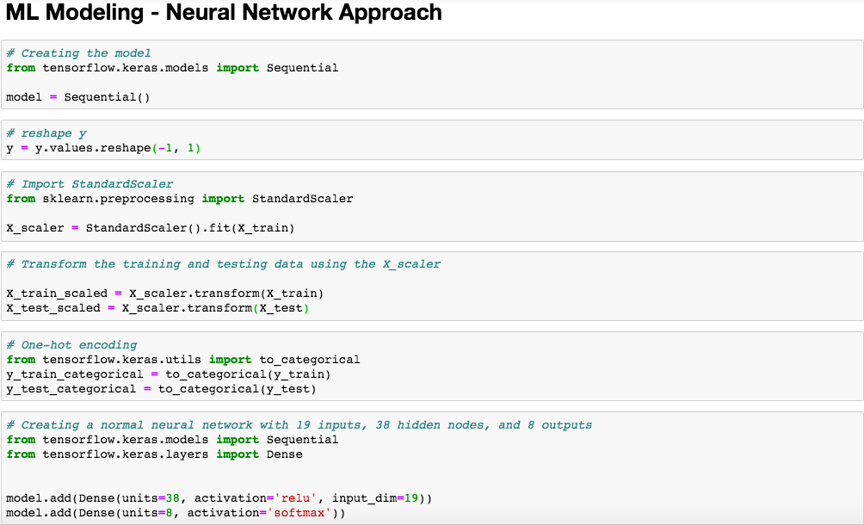
Machine Learning - Neural Network
Notes:
Next we decided to go with a neural network approach. First we created the model then reshaped y. Afterwards, we scaled x and one-hot encoded y. Then we built the actual neural network using keras and tensorflow.

Slide 17
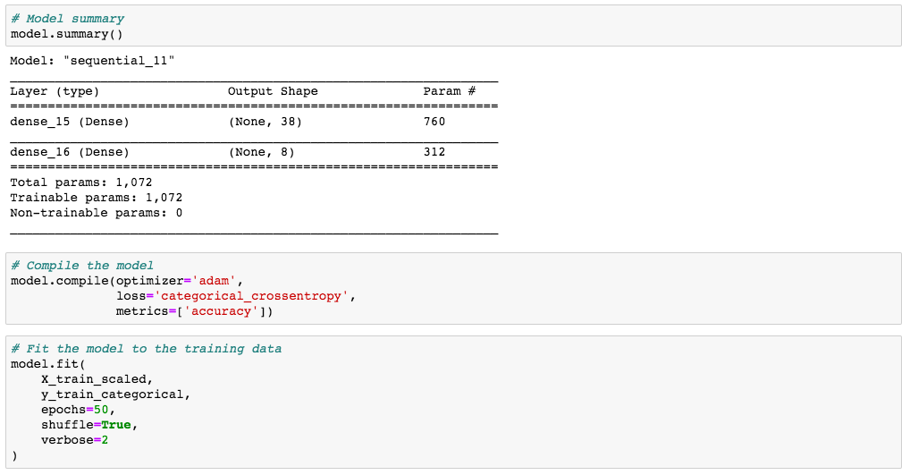
Machine Learning - Neural Network
Notes:
Quick model summary. We then compiled and fit the model

Slide 18
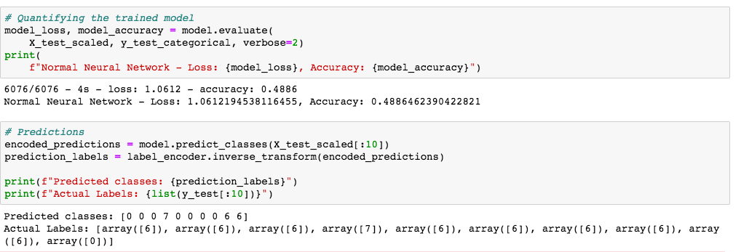
Machine Learning - Neural Network
Notes:
As you can see, the neural network did not give much better results than logistic regression.

Slide 19
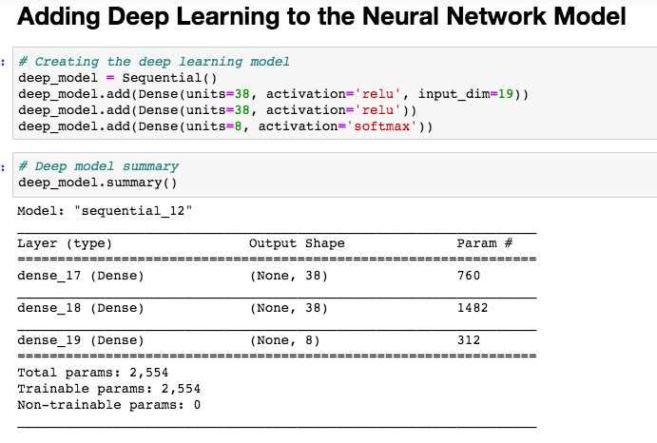
Machine Learning - Neural Network
Notes:
To try and get better results, we decided to add deep learning to our model. We only added one extra layer because we did not want to overfit

Slide 20
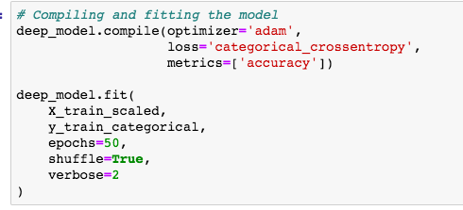
Machine Learning - Neural Network
Notes:
Compiling and fitting the model

Slide 21
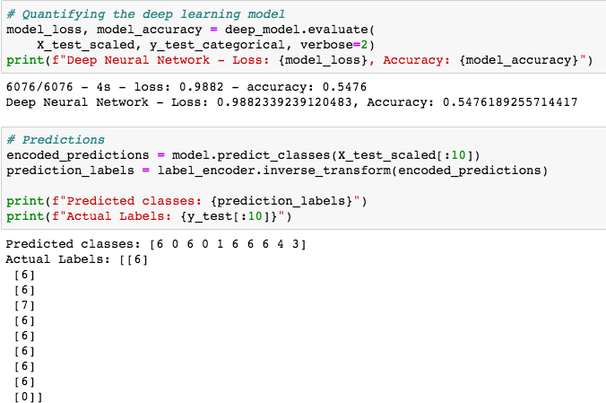
Machine Learning - Neural Network
Notes:
Model results: best results so far but not great. We concluded that this dataset just wouldn’t yield the best results.

Slide 22
Tableau
We used tableau to create tableau which is a great tool for visualization.
With tableau, we can change or transform data into an easily understandable format without any coding skills
We used our already cleaned data to translate queries into visualization.
We imported the two data and using a join. We brought the two dataset together in tableau.
Notes:
Switches to Kela

Slide 23
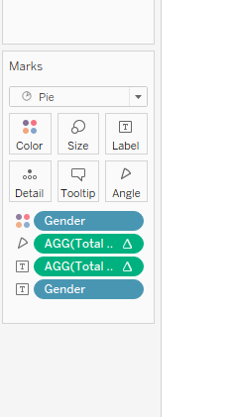
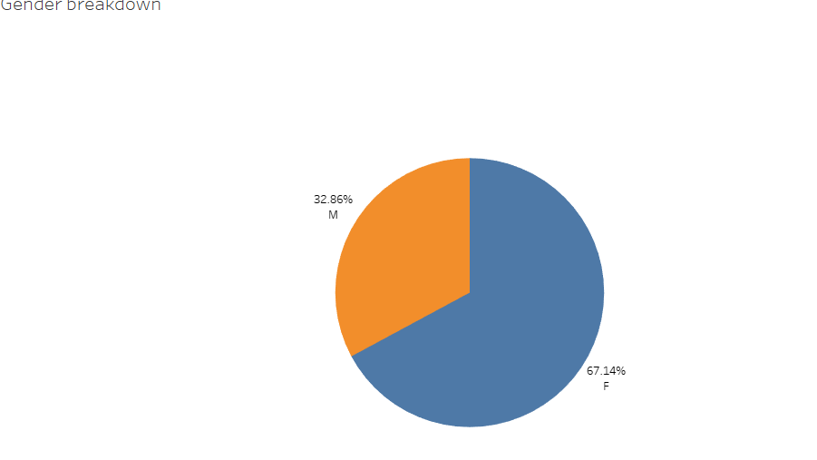
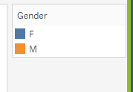
Gender Breakdown
Notes:
Pie chart is usually used to show proportions of a whole. First we use a calculated field to get the total number of client.

Slide 24
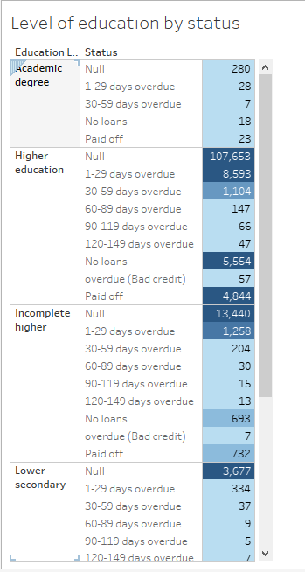
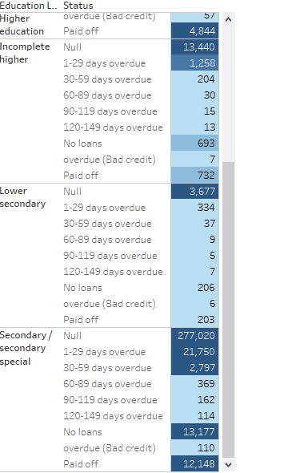
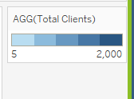
Level of Education
Notes:
Text table or cross table, we assigned an aliases which means giving an alternative name for our status, we compared the level of education to status.

Slide 25
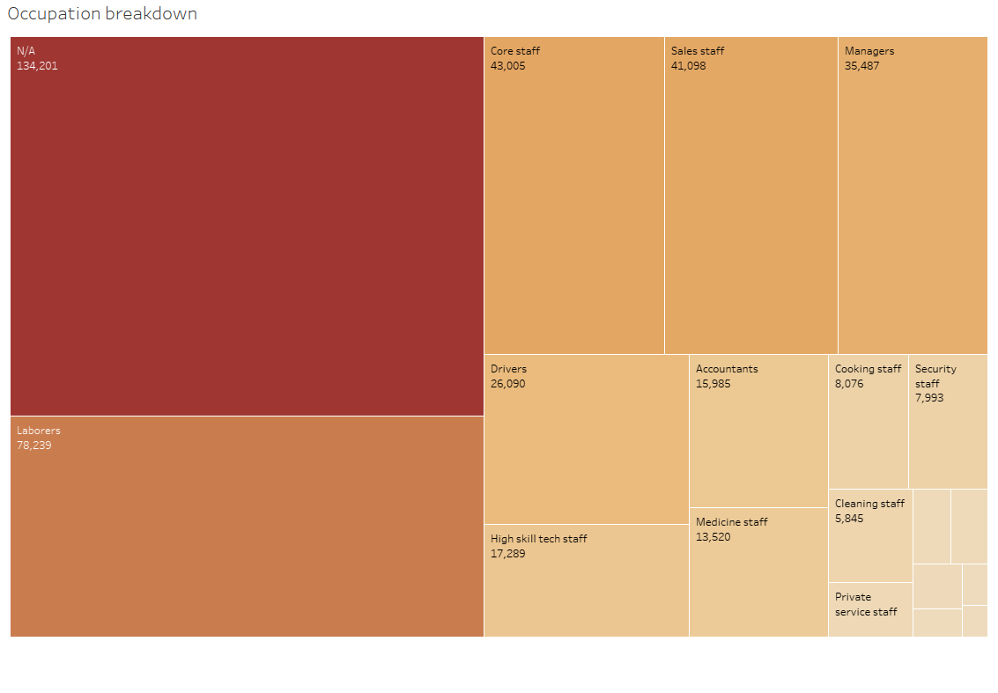

Occupational Breakdown
Notes:
Tree map displays data in nested rectangles

Slide 26
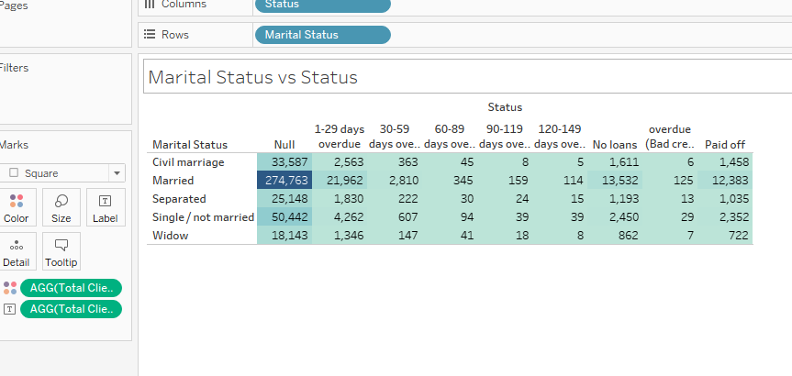
Notes:
Text table

Slide 27
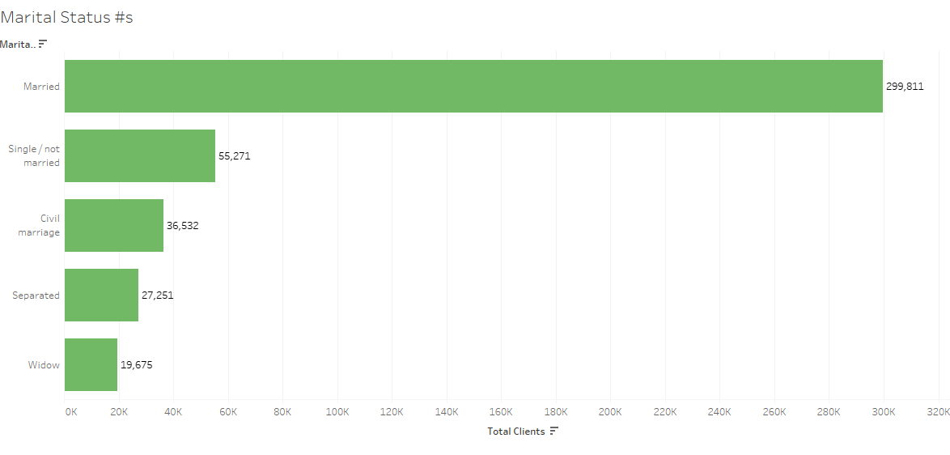
Martial Status
Notes:
Horizontal bar

Slide 28
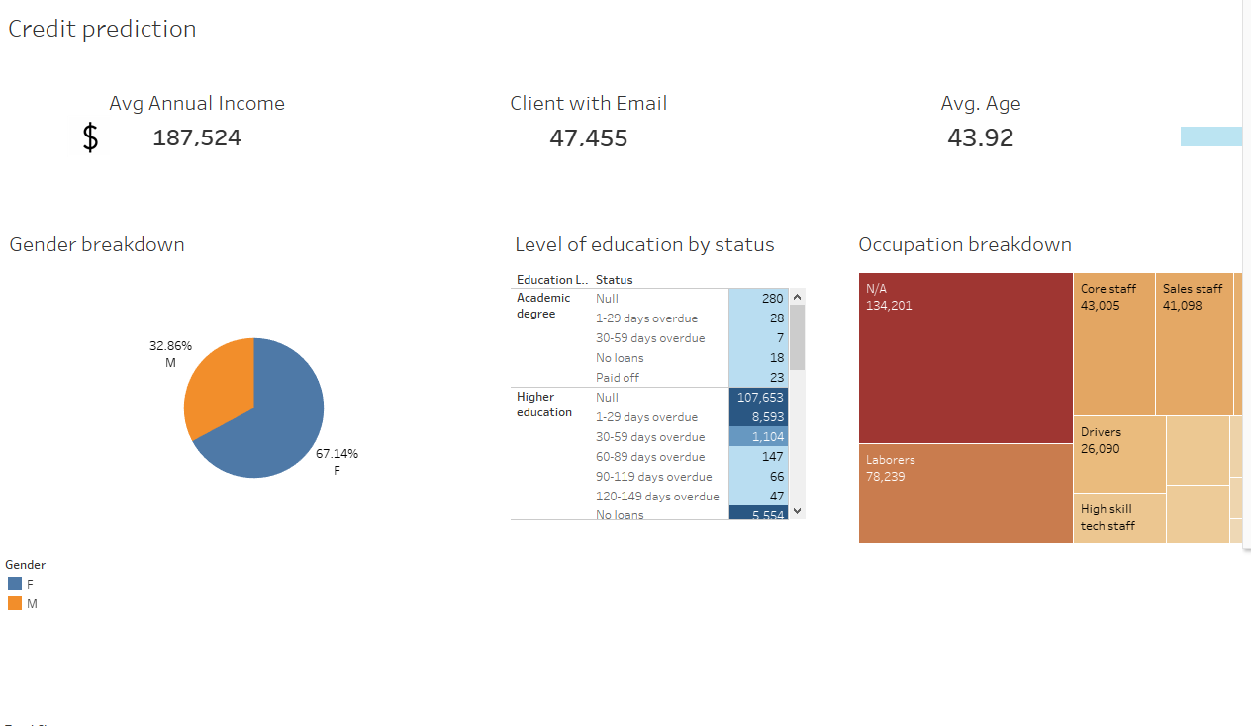
Notes:
Dashboard. Shayna starts

